Slide 1
Swipe Meets Dream
Get inspired and go!

Slide 2
Our Audience
Young, busy, maybe working full-time
Dislike or don’t have time to research possible destinations
Dislike or don’t have time to research and compare various vacation options
Need inspiration and ability to book vacations easily all in one spot
Social media users, dating app users who like these quick interfaces

Slide 3
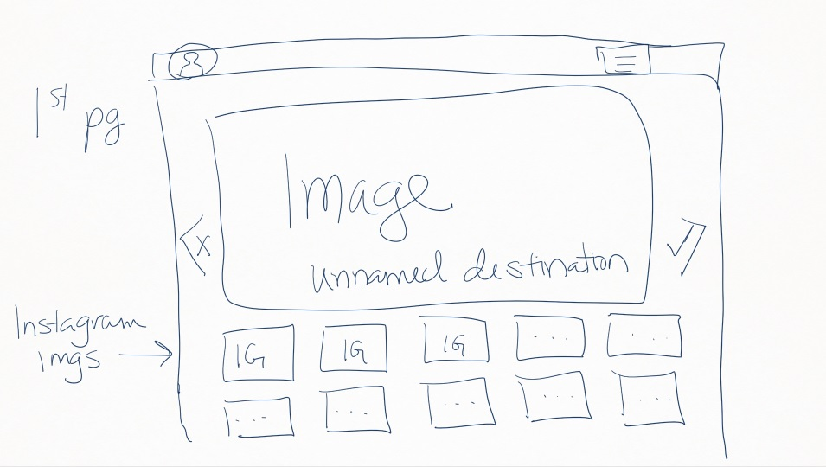
Landing
User will land on a sign in page and create an account
Once signed-in, random destinations will be generated for user to get inspo from
Includes main header photo
Smaller, “explorable” images below
If not inspired by the destination images, they can swipe L
If the images inspire them, they can swipe R
These locations will be committed to our DB for later use

Slide 4
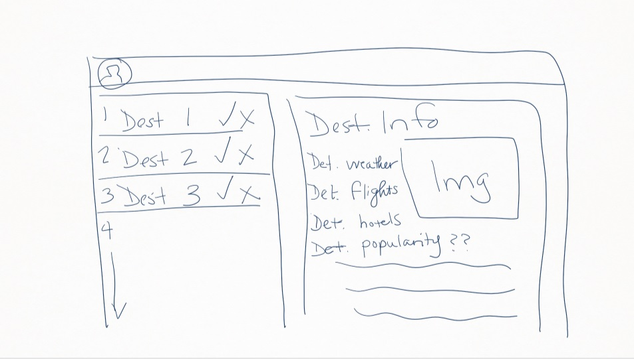
Summary/Results Page
Lists all R swipes in clickable menu
When user clicks on an option, they get a summary of destination details
Avg Weather
Avg hotel prices
Avg flight prices
Links to booking sites for each option

Slide 5
Technology Used
UIKit Framework for CSS
Use of “swipe” interaction
Designing to emulate a Tinder-like experience to “match” user to destinations and interact with them
Ember JS
Various Travel APIs
Sygic
Sabre
Possible Social APIs
Instagram or other photo API

Slide 6
Future Development/Features
Landing page
Gather user input to provide more customized suggestions
Budget
Available dates
R Swipes
Custom pre-generated travel packages
Packages generated and suggested based on total budget
Excursions, etc
Can be booked in single click
Summary of matches can be sorted by various variables ie.
Days lost to travel
Distance traveled
Total cost
Etc
Algorithm Development
Generate more customized recommendations based on previous bookings, swipe history, integrate with other social media platforms to collect user information

